Slide 1


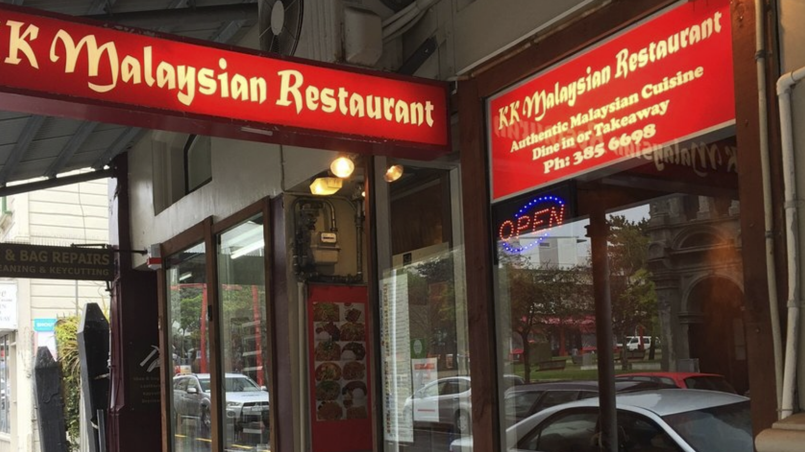
COMP312/OPRE354 GROUP6 PROJECT
Andy Yang / Minping Yang / Haochen Yin/ Zhu Xinyu

Slide 2
project objective
Making observation and Simulate a real-life service unit
Application of queuing theory and simulation modelling
Parsing useful information from a huge dataset
Analyzing relevant data from observed data
Find well-fit distributions
Simulate the service system using different models
Evaluate system performance and accuracy
Draw a conclusion
Provide suggestions to help improve system performance

Slide 3

Introducing our server unit
Quick info about KK
Quick service rate
Dine in: 9 tables / 35 people
Small space to form a queue
Different assumption for allowing queue formation
Assume fixed service time/rate at kitchen side
Arrival% assumed random
Fixed #server: 2 waiters
Notes:
Hi everyone!

Slide 4

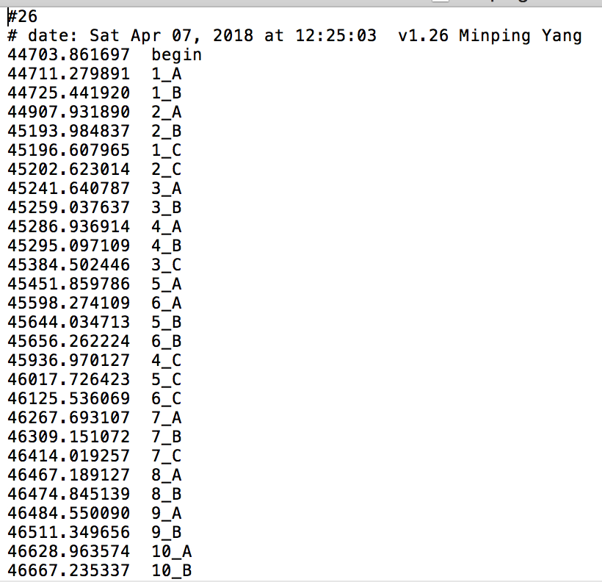
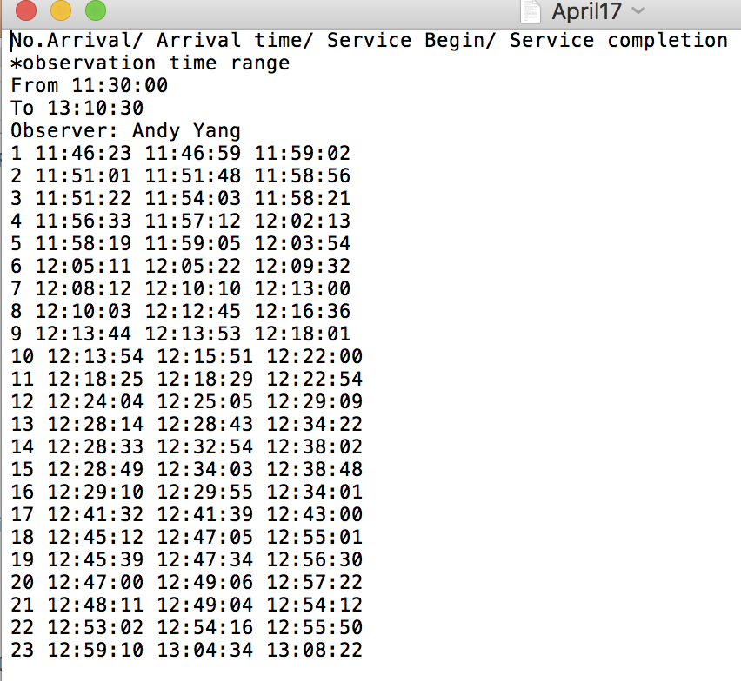


Data collection
$$\left.76\% (\frac{214}{279}\right)$$
Column-wise manual records
$23\% (\frac{65}{279})$
monitor.py

Slide 5
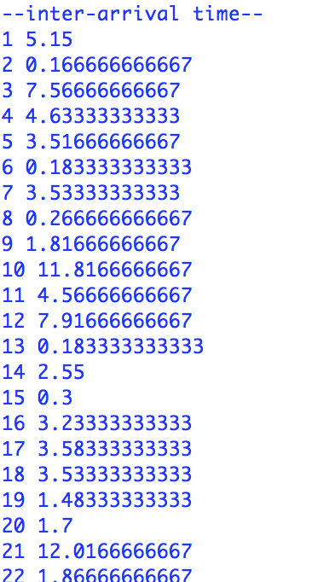
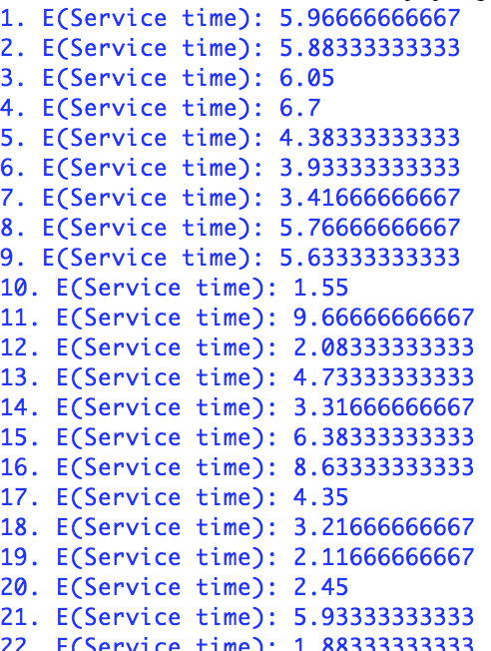
Observation outcomes
Poisson Arrival at random
Variations of service rate
(affecting kitchen’s service%)
meal type
Take-away collection
Variations of queuing time
(affecting waiter’s service%)
Regular customers
Delayed order-taking

Slide 6


Performance measure
$$Observed W=\frac{Σ(Customer\left(i\right)Service completion − Arrive time of customer(i))}{number of customers(279)}$$
 | observed value
W | 5.9608 mins
Wq | 1.2387 mins
Ws | 4.6649 mins
$$Arrival rate\%=0.215 per minutes (12.8/hour)$$
$$E\left(S\right)=\frac{1}{μ}=\frac{1}{0.2123}=4.71 minutes (average service time)$$

Slide 7
Data analysis
 | Gamma | Erlang | Exponential
Inter-arrival time | test statistic: 21.038 p-value: 0.00031 | test statistic: 281.79 p-value: 6.498*10⁻⁵⁸ | test statistic: 20.76 p-value: 0.00089
Service time | test statistic: 1.05 p-value: 0.305329 | test statistic: 68.04 p-value: 1.60*10⁻¹⁶ | test statistic: 130.074 p-value: 2.295*10⁻²⁶
fit_alpha, fit_loc, fit_beta = ss.gamma.fit(data, floc=0)
fit_alpha, fit_loc, fit_beta = ss.erlang.fit(data, floc=0)
fit_lamda, fit_loc, = ss.expon.fit(data, floc=0)
Number of bins = (1+ log₂^{N})
The parameter estimation in ss.gamma is E(X) = alpha*beta, V(X) = alpha*beta*beta

Slide 8
Data analysis
Why are inter-arrival times mostly exponentially distributions
1. Observation time period
2. Not as easily affected as service times..
Why are service times gamma distributed
1. Staff may not be solely doing one specific job.
2. Orders do not take a fixed amount of time.
Customers order extra things
……….

Slide 9
Data analysis
Our chosen distribution (gamma) for service times looks good : with p-value = 0.305329
Inter-arrival times being exponentially distributed are very not likely : with p-value = 0.000899
The reason for this could be that inter-arrival times are not always ideally exponentially distributed.
Bad weather
Observation times
………..
Null hypothesis : inter-arrival times are exponentially distributed.
Should reject null hypothesis.

Slide 10
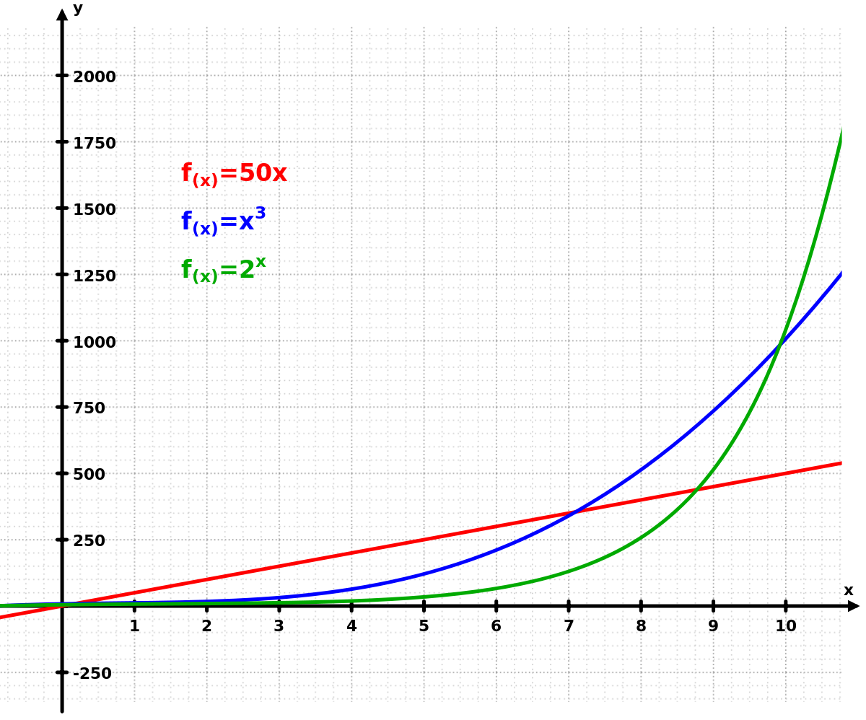
Data analysis

Slide 11
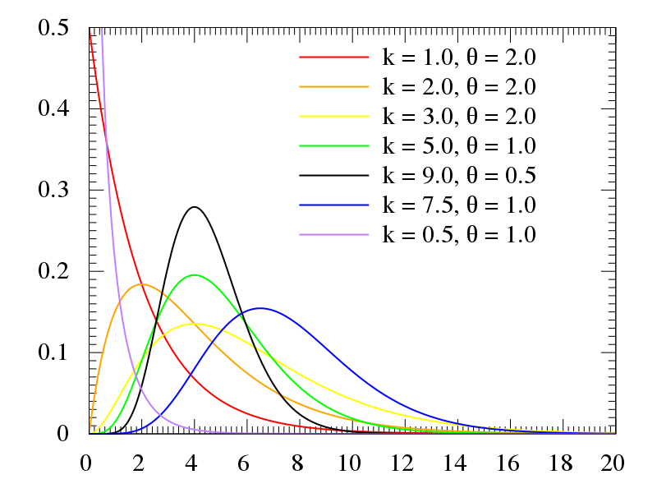
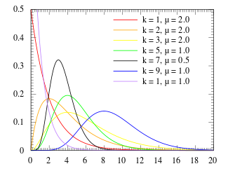
Data analysis

Slide 12
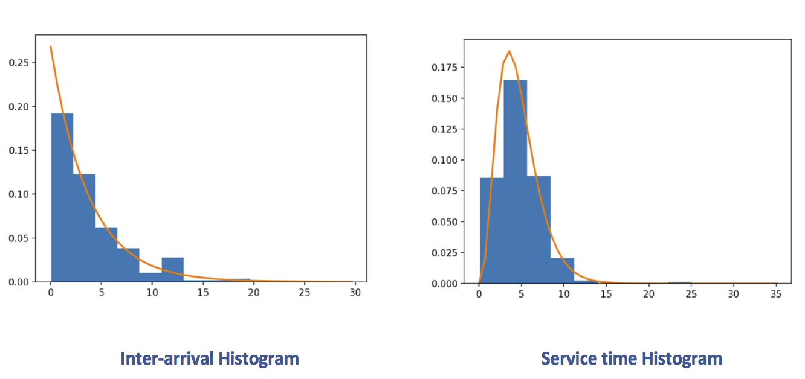
Data analysis

Slide 13
M1 model- m/m/2
 | Estimated value | 95% confidence interval
W (average waiting time in the system) | 7.82337206711 | 7.809121917413742 | 7.837622216805047
Wq (average waiting time in the queue) | 3.11337407736 | 3.0948807792369624 | 3.1318673754882353
Ws (average waiting time in the service) | 4.70833321818 | 4.704664109569529 | 4.7120023267810565
Not very accurately simulated! With Poisson inter-arrival and exponential service time

Slide 14

M2 model
$$pdf\left(x\right)= \frac{x^{alpha−1}∗math.exp⁡(\frac{−x}{beta})}{math.gamma \left(alpha\right)∗{beta}^{alpha}}$$
Inter-arrival follows Exponential distribution
Service time follows Gamma distribution
Exponential distribution | Lambda = 0.267770516023
Gamma distribution | Alpha = 3.876165 | Beta = 1.214991
 | Estimated value | 95% confidence interval
W (average waiting time in the system) | 6.7056019466 | 6.679096919947189 | 6.73210697325375
Wq (average waiting time in the queue) | 1.99837885424 | 1.9742759920546804 | 2.022481716421073
Ws (average waiting time in the service) | 4.70721556874 | 4.703045184310918 | 4.7113859531765705
Better simulation than Model1 but still have room to improve.

Slide 15
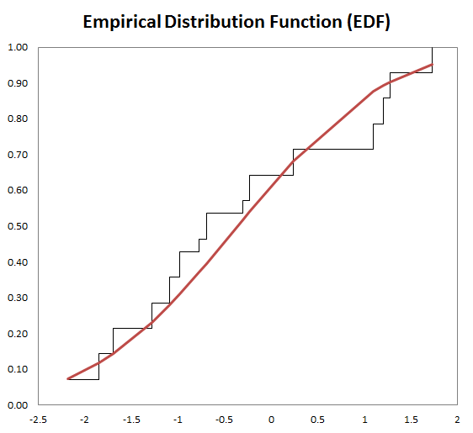

Empirical DITRIBUTION MODEL
{ X⁽¹⁾, X⁽²⁾, X⁽³⁾, X⁽⁴⁾, X⁽⁵⁾, X⁽⁶⁾, X⁽⁷⁾, X⁽⁸⁾.......}
{ W⁽¹⁾, W⁽²⁾, W⁽³⁾, W⁽⁴⁾, W⁽⁵⁾, W⁽⁶⁾,.....}
F^{(i)}=$\frac{number of observations Xj that are <= W(i)}{n}$
x = W^{(k)} + ($\frac{r−F(k)}{F(k+1) − F(k)}$)( W^{(k+1)}-W^{(k)})
(where W⁽⁰⁾ = F⁽⁰⁾=0)

Slide 16
Summery of 3 simulation models
 | M/M/2 model | Fittest distribution model | Empirical model
Estimated W 95% CI | 7.82 (7.80,7.84) | 6.70 (6.68,6.73) | 6.517 (6.492,6.541)
Estimated W_{s} 95% CI | 4.708 (4.704,4.712) | 4.707 (4.703,4.711) | 4.641 (4.636,4.646)
Estimated W_{q} 95% CI | 3.11 (3.09,3.13) | 1.99 (1.97,2.02) | 1.875 (1.854,1.897)
$$Observed W=\frac{Σ(Customer\left(i\right)Service completion − Arrive time of customer(i))}{number of customers(279)}=5.96 mintutes$$

Slide 17
Thank you for your attention.
Any questions?

